Slide 1
Latest trends on alcohol consumption in Scotland from the Alcohol Toolkit Study
Vera Buss, Jamie Brown, Loren Kock

Slide 2
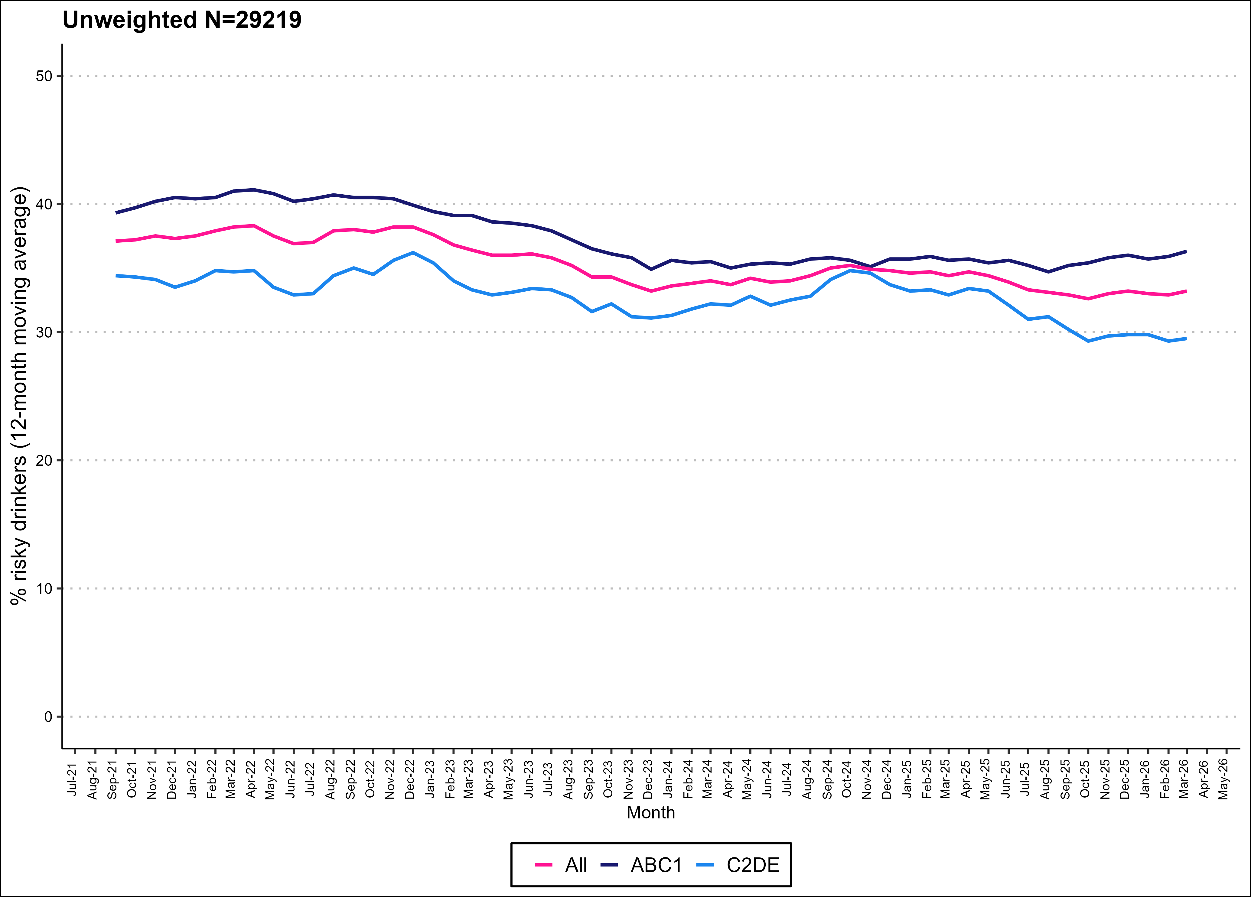
Prevalence of risky drinking (AUDIT-C) by social grade

Slide 3
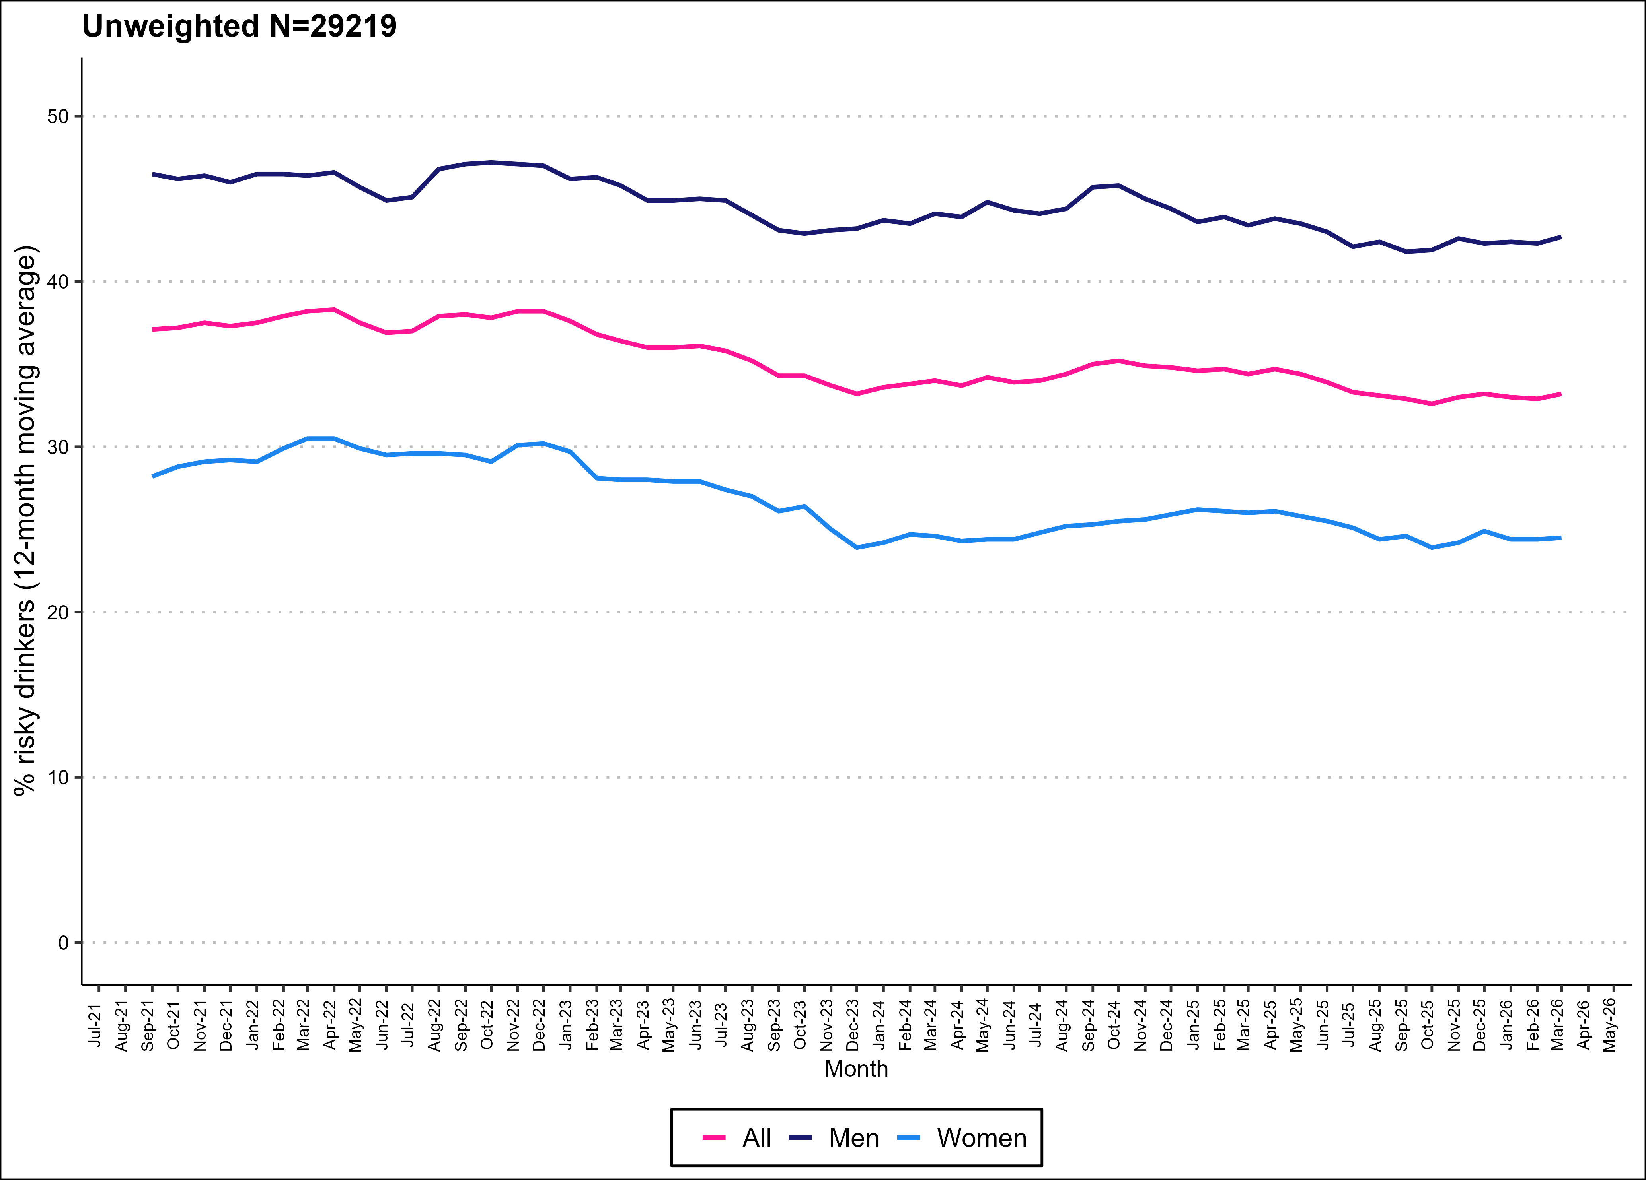
Prevalence of risky drinking (AUDIT-C) by gender

Slide 4
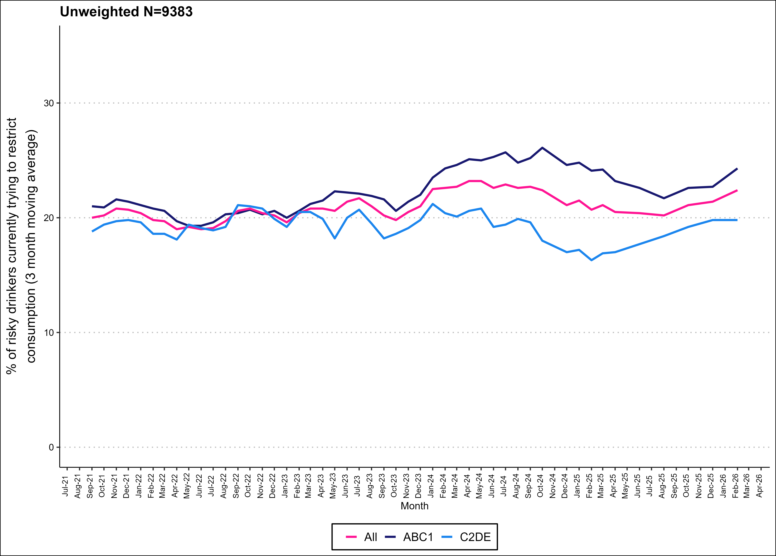
Currently trying to restrict consumption

Slide 5
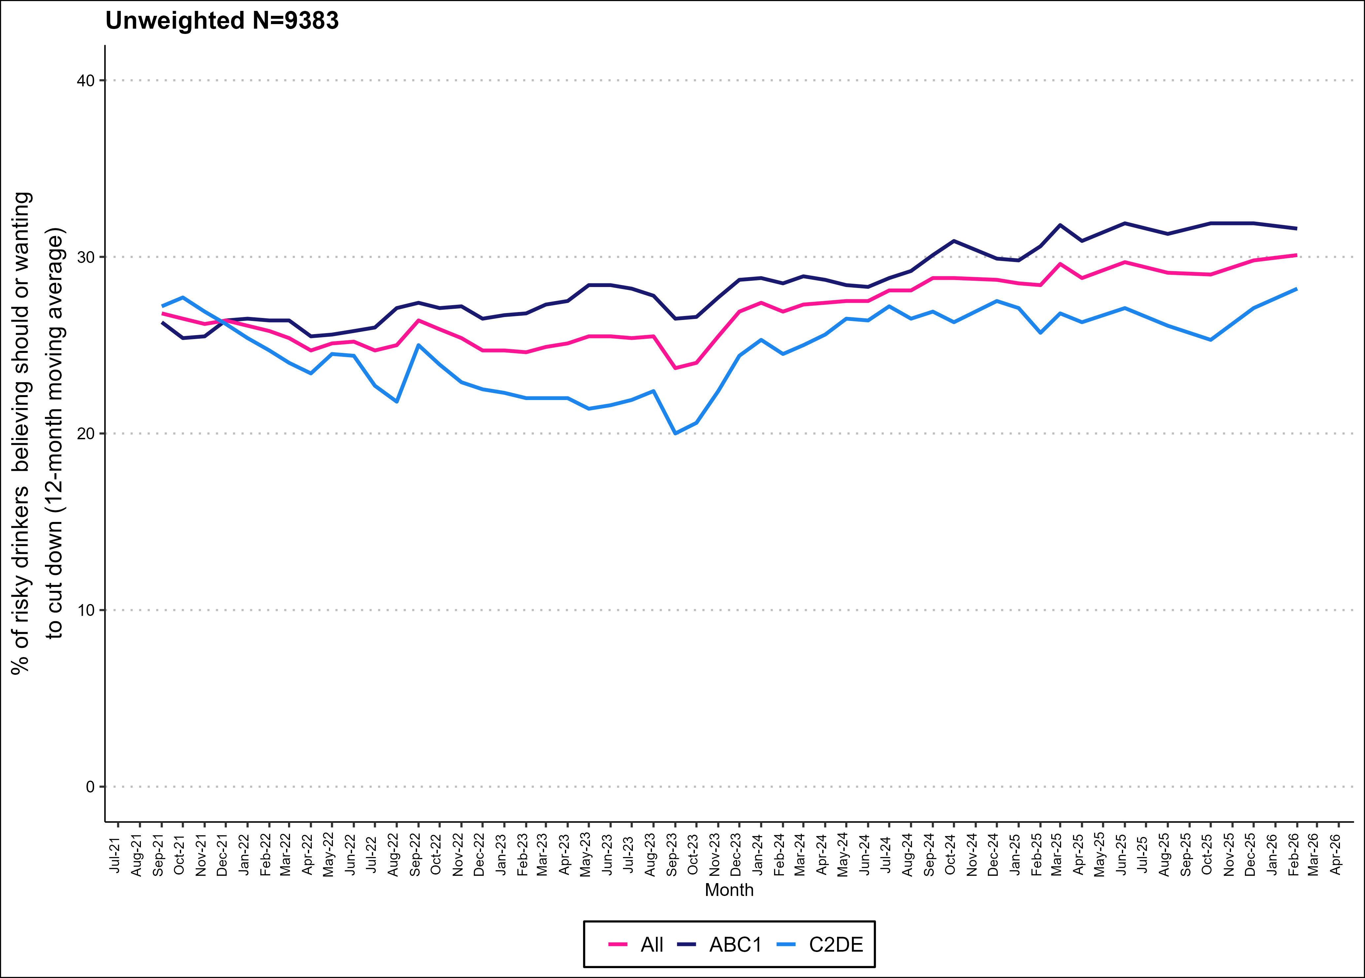
Motivation to cut down

Slide 6
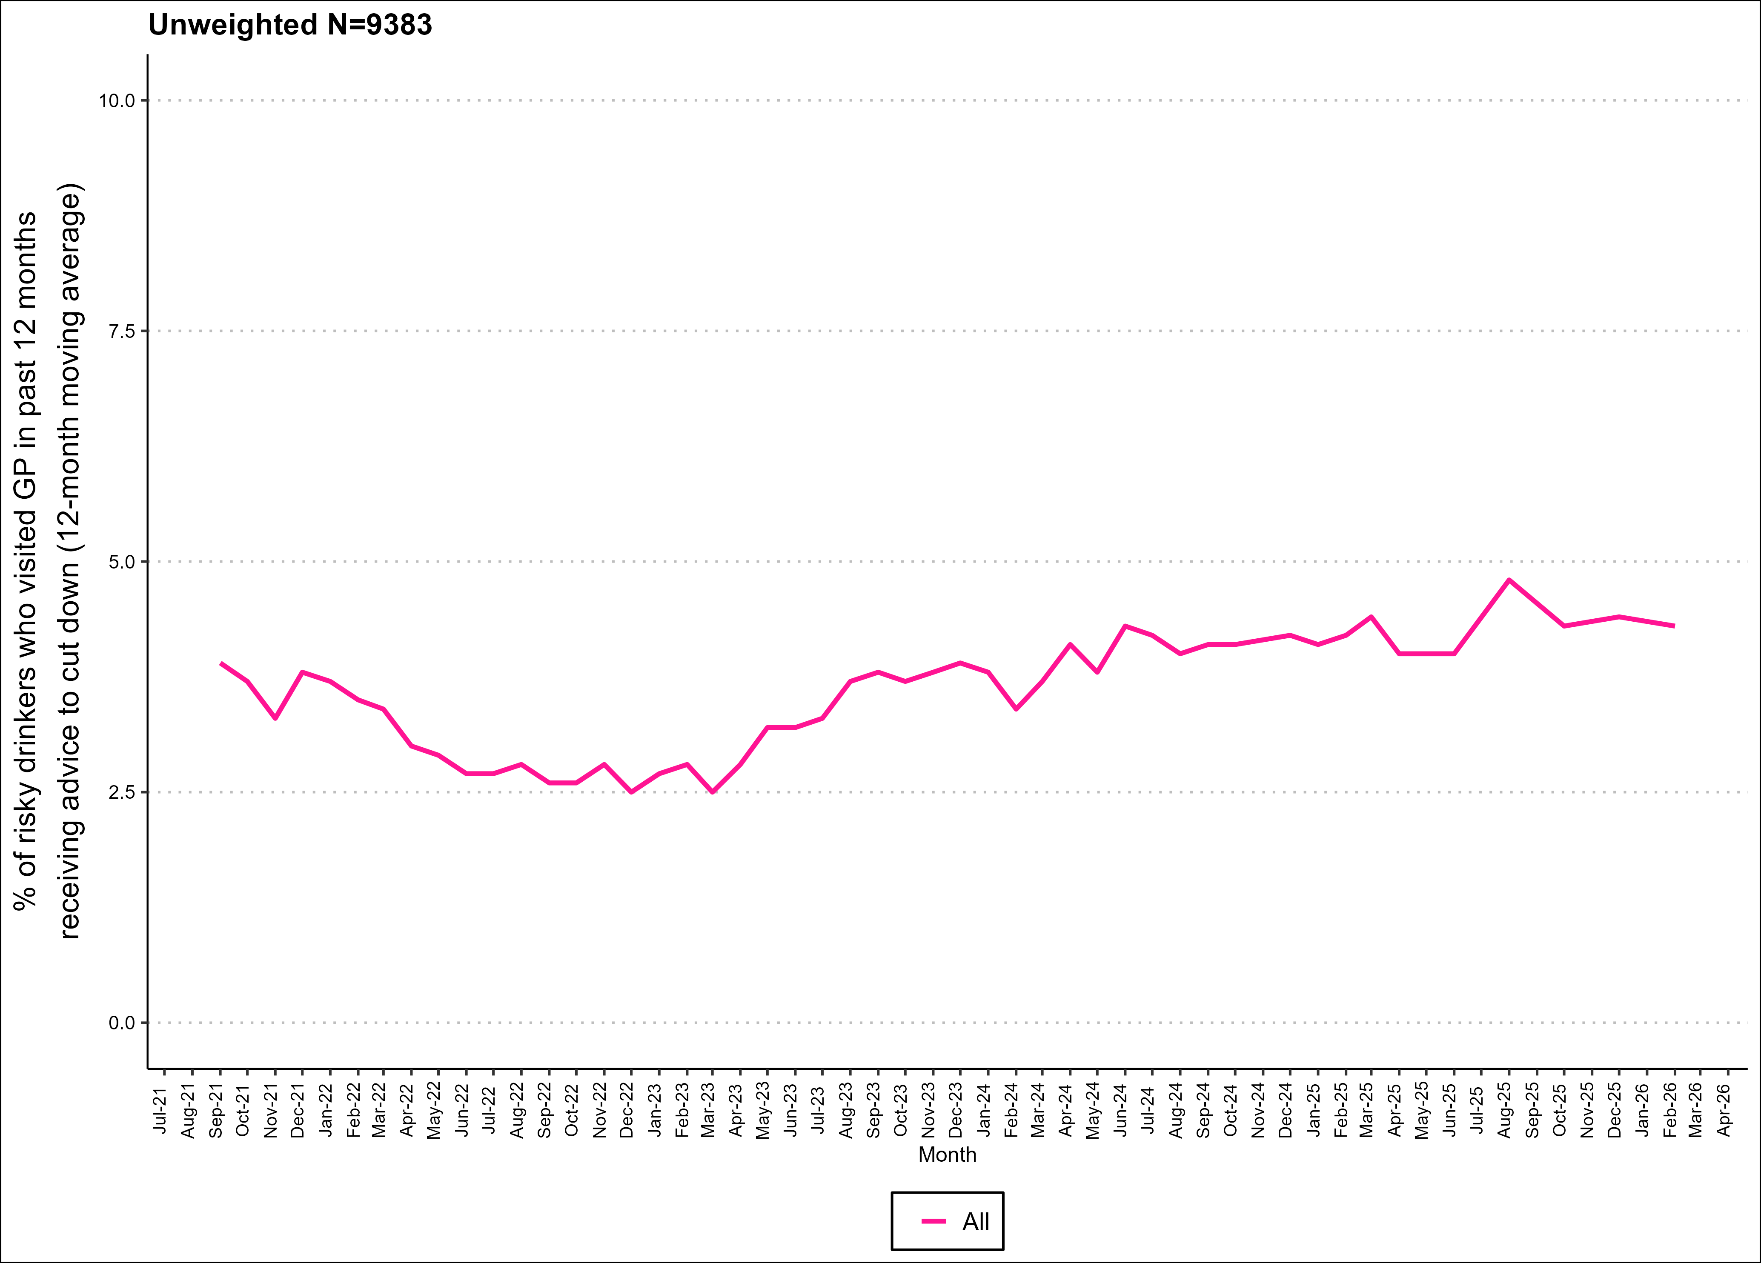
GP advice to cut down

Slide 7
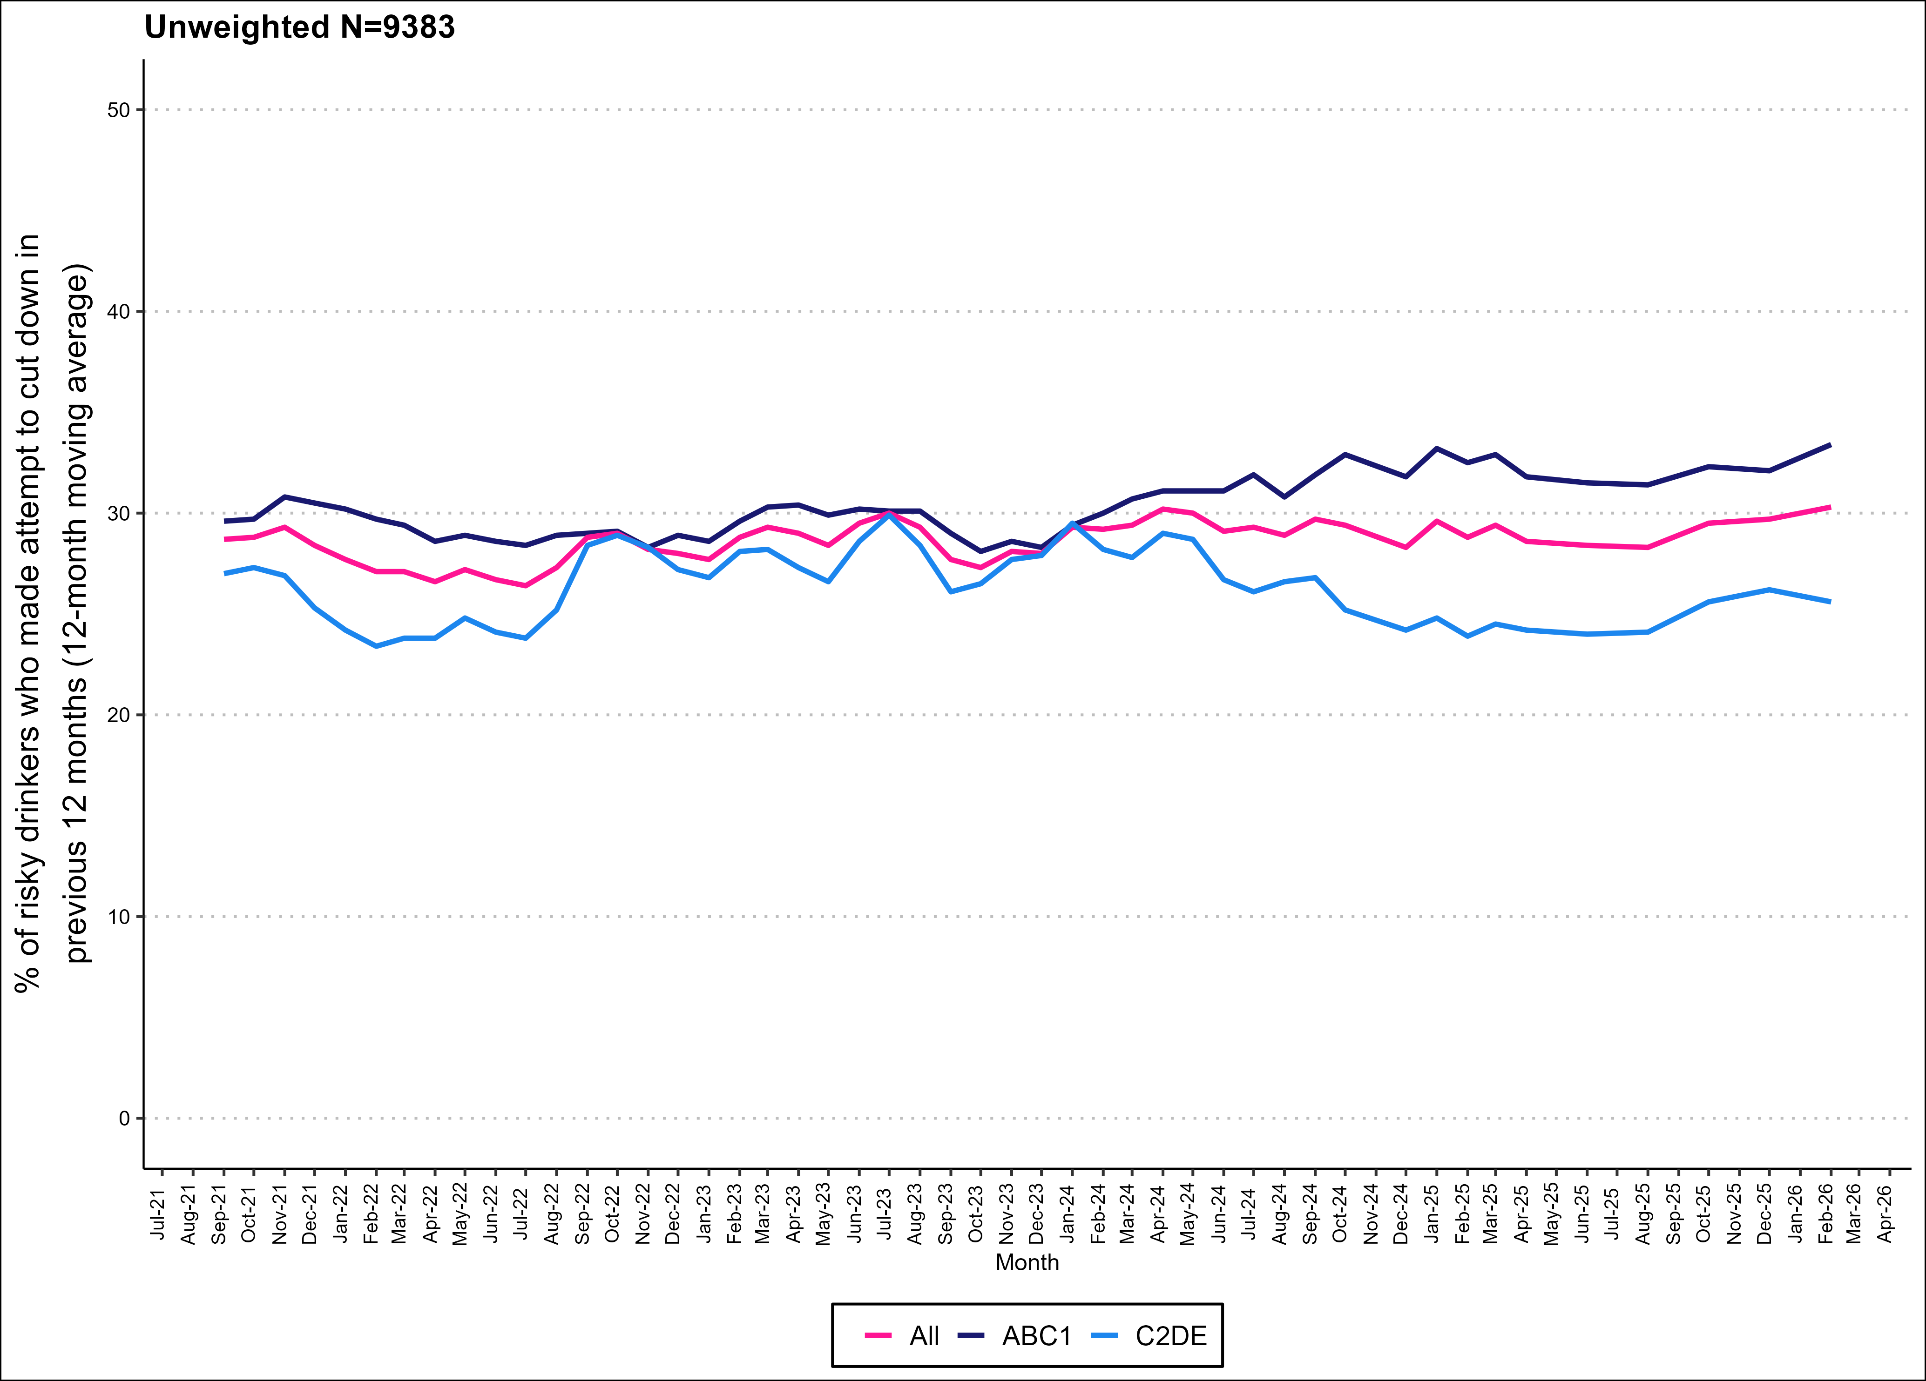
All past-year attempts to cut down or stop

Slide 8
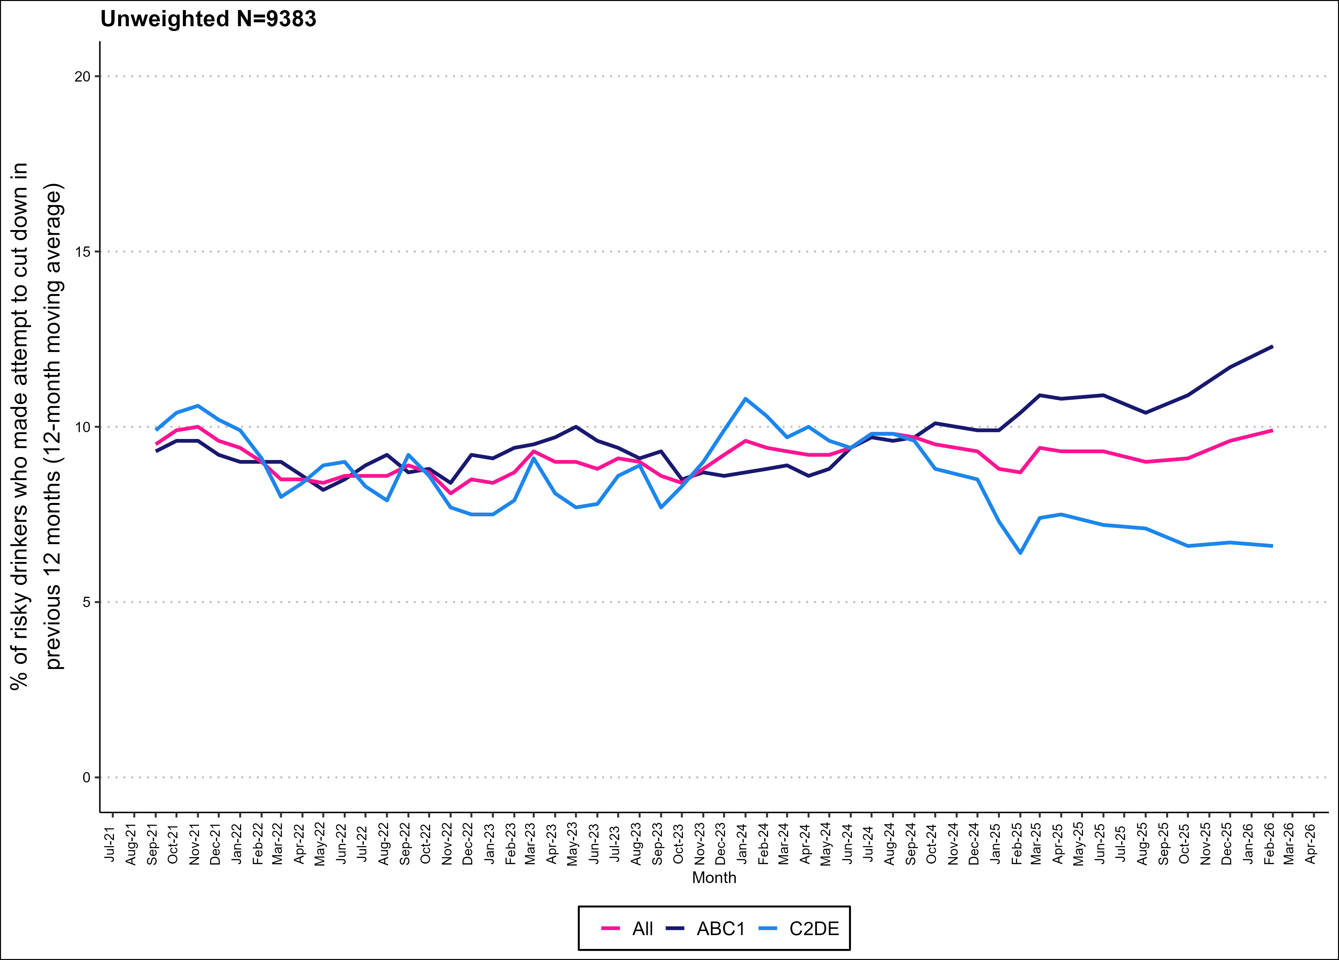
Serious past-year attempts to cut down or stop

Slide 9
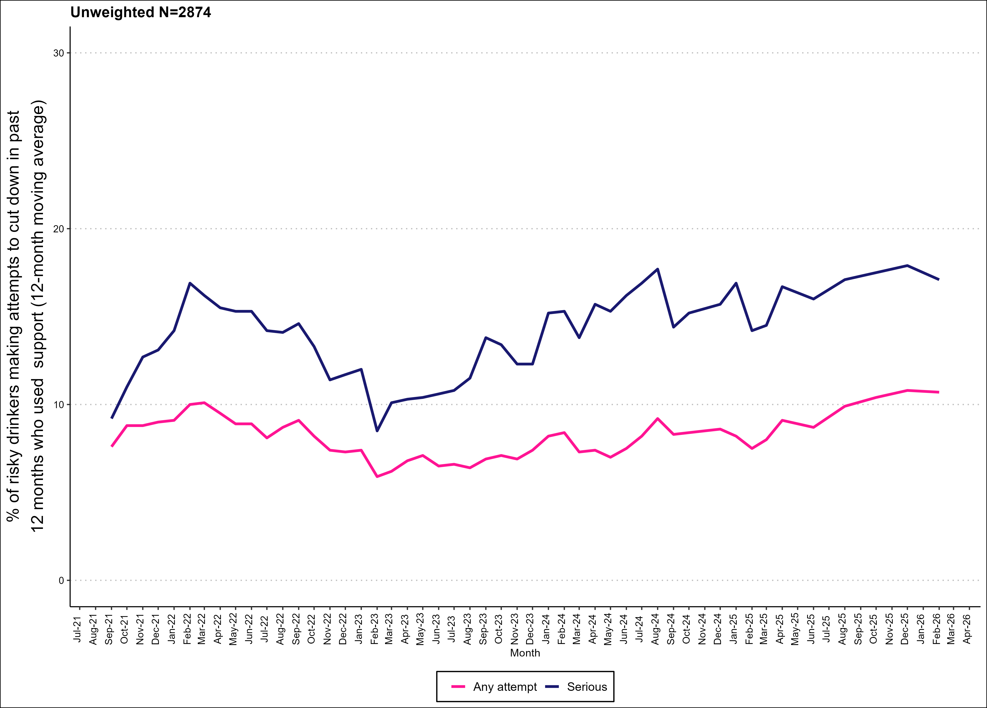
Support in past-year attempts

Slide 10
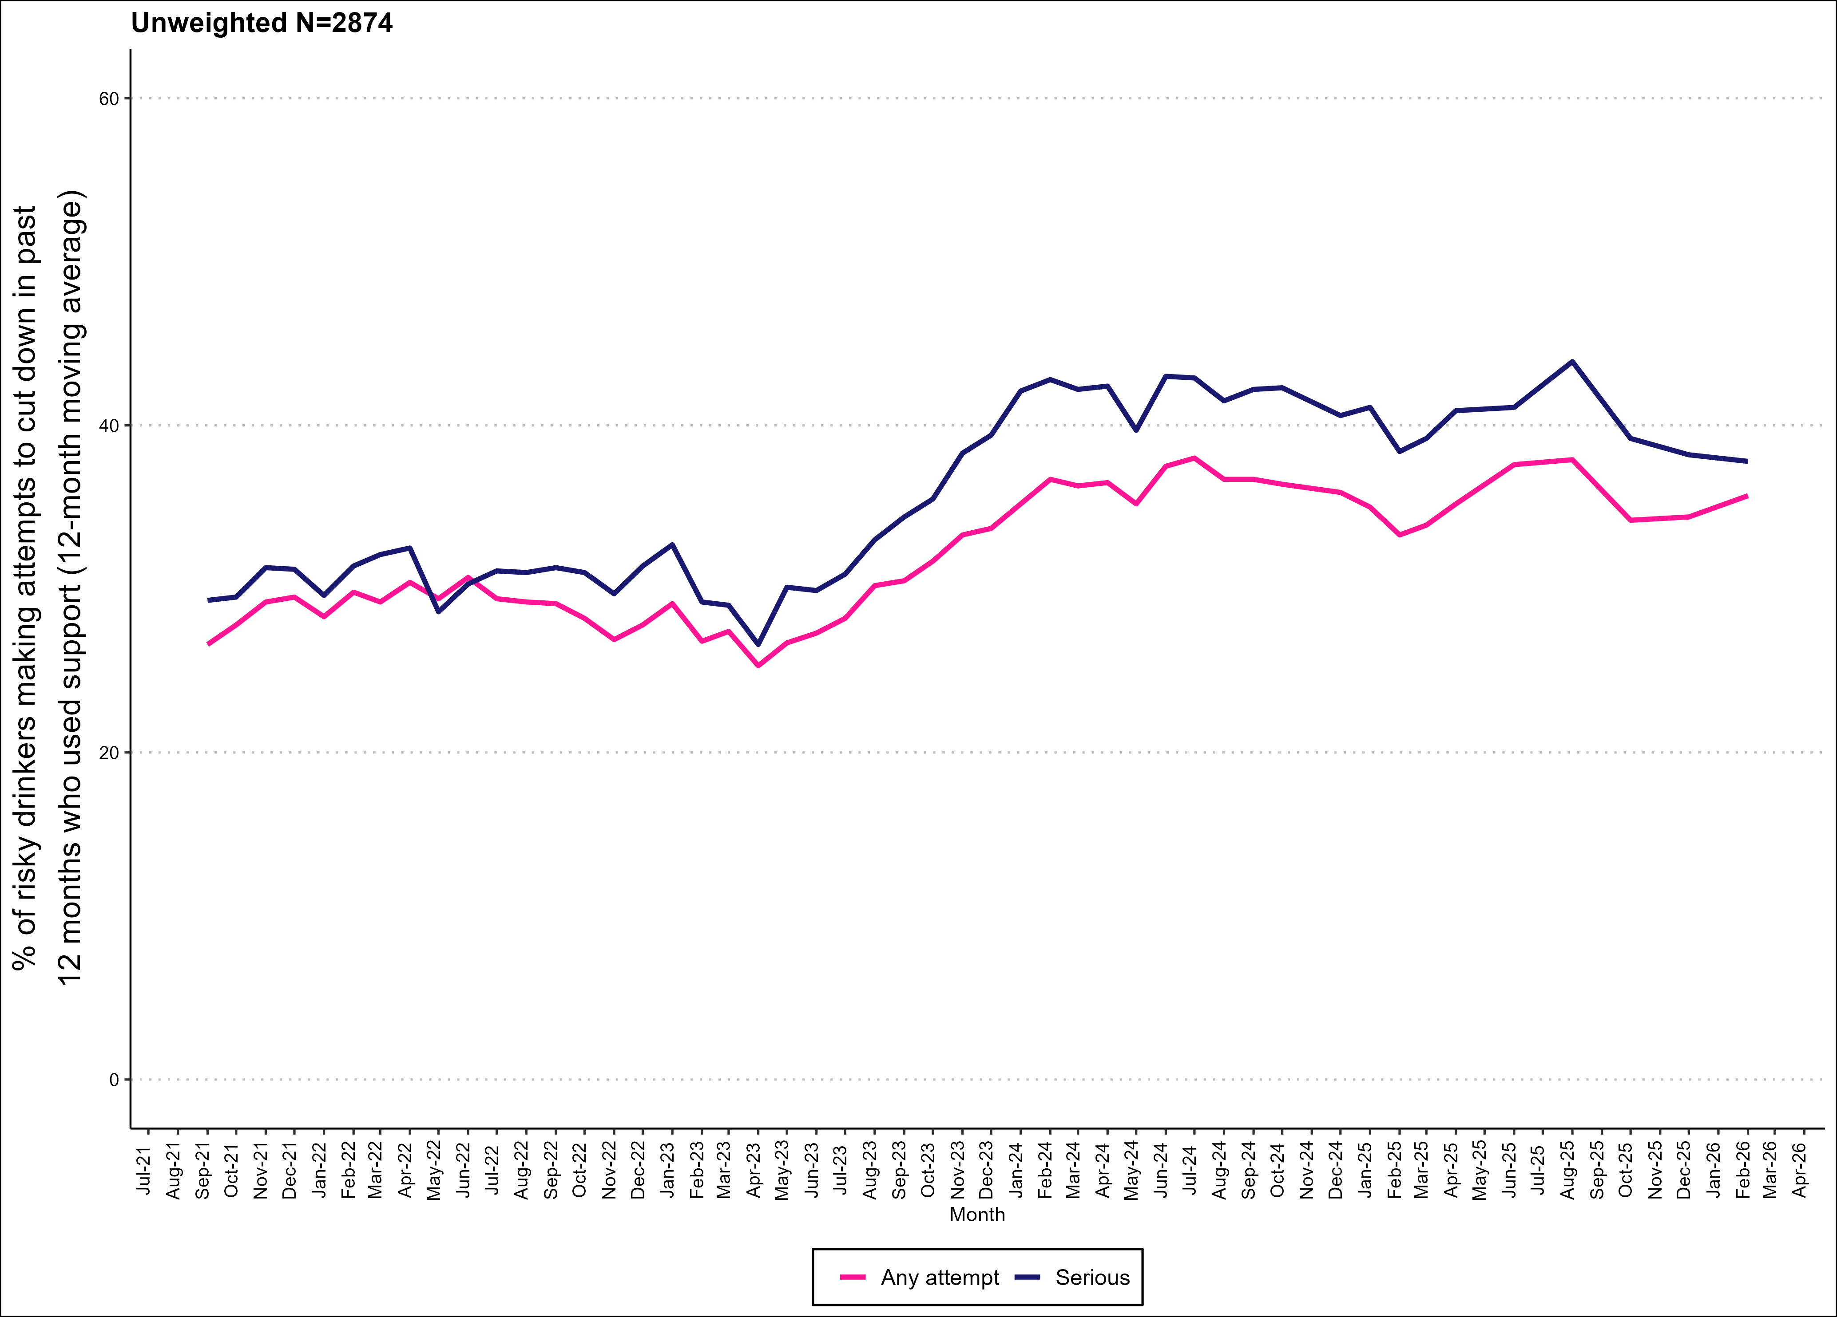
Using low-alcohol/alcohol-free drinks in past-year attempts

Slide 11
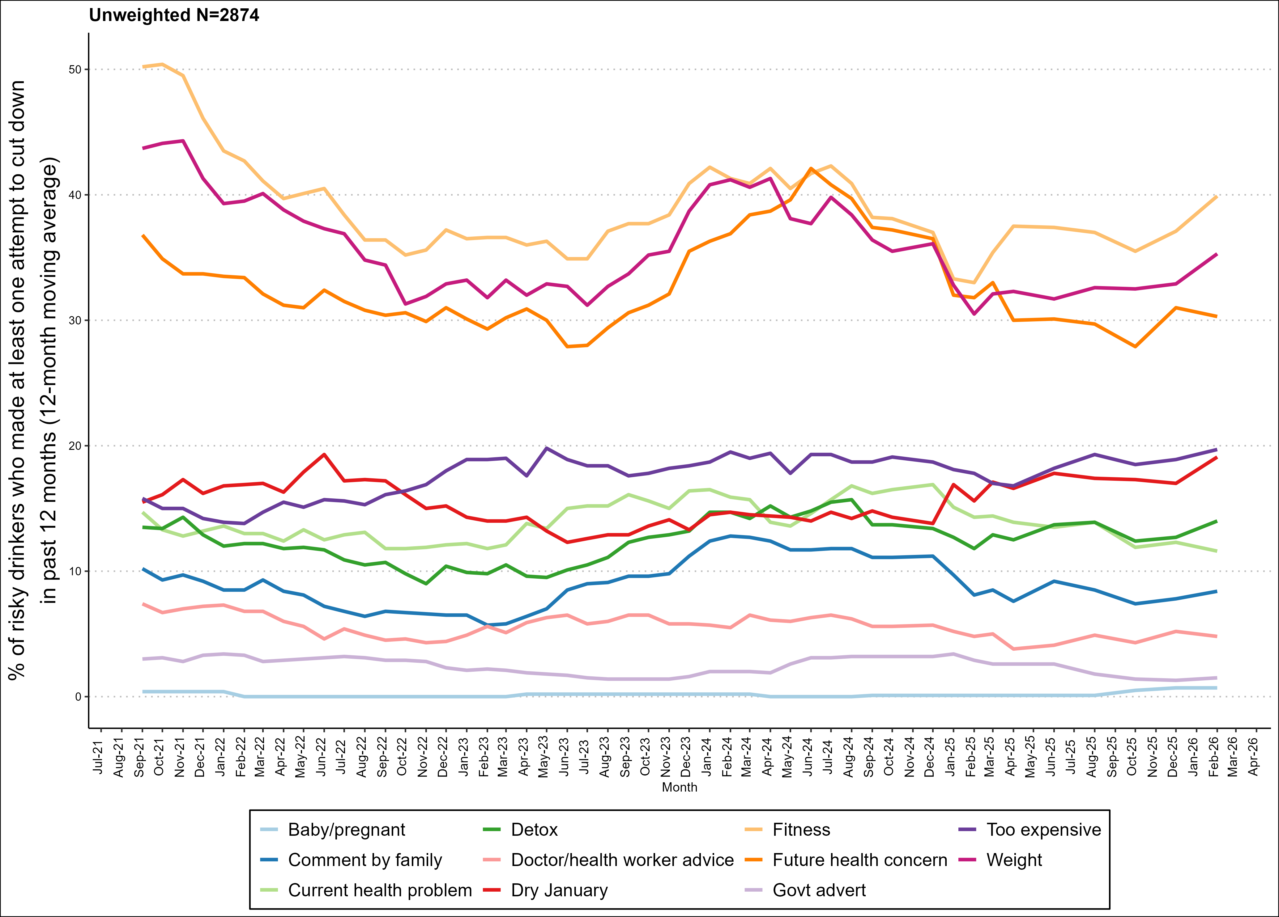
Triggers for past-year attempts

Slide 12
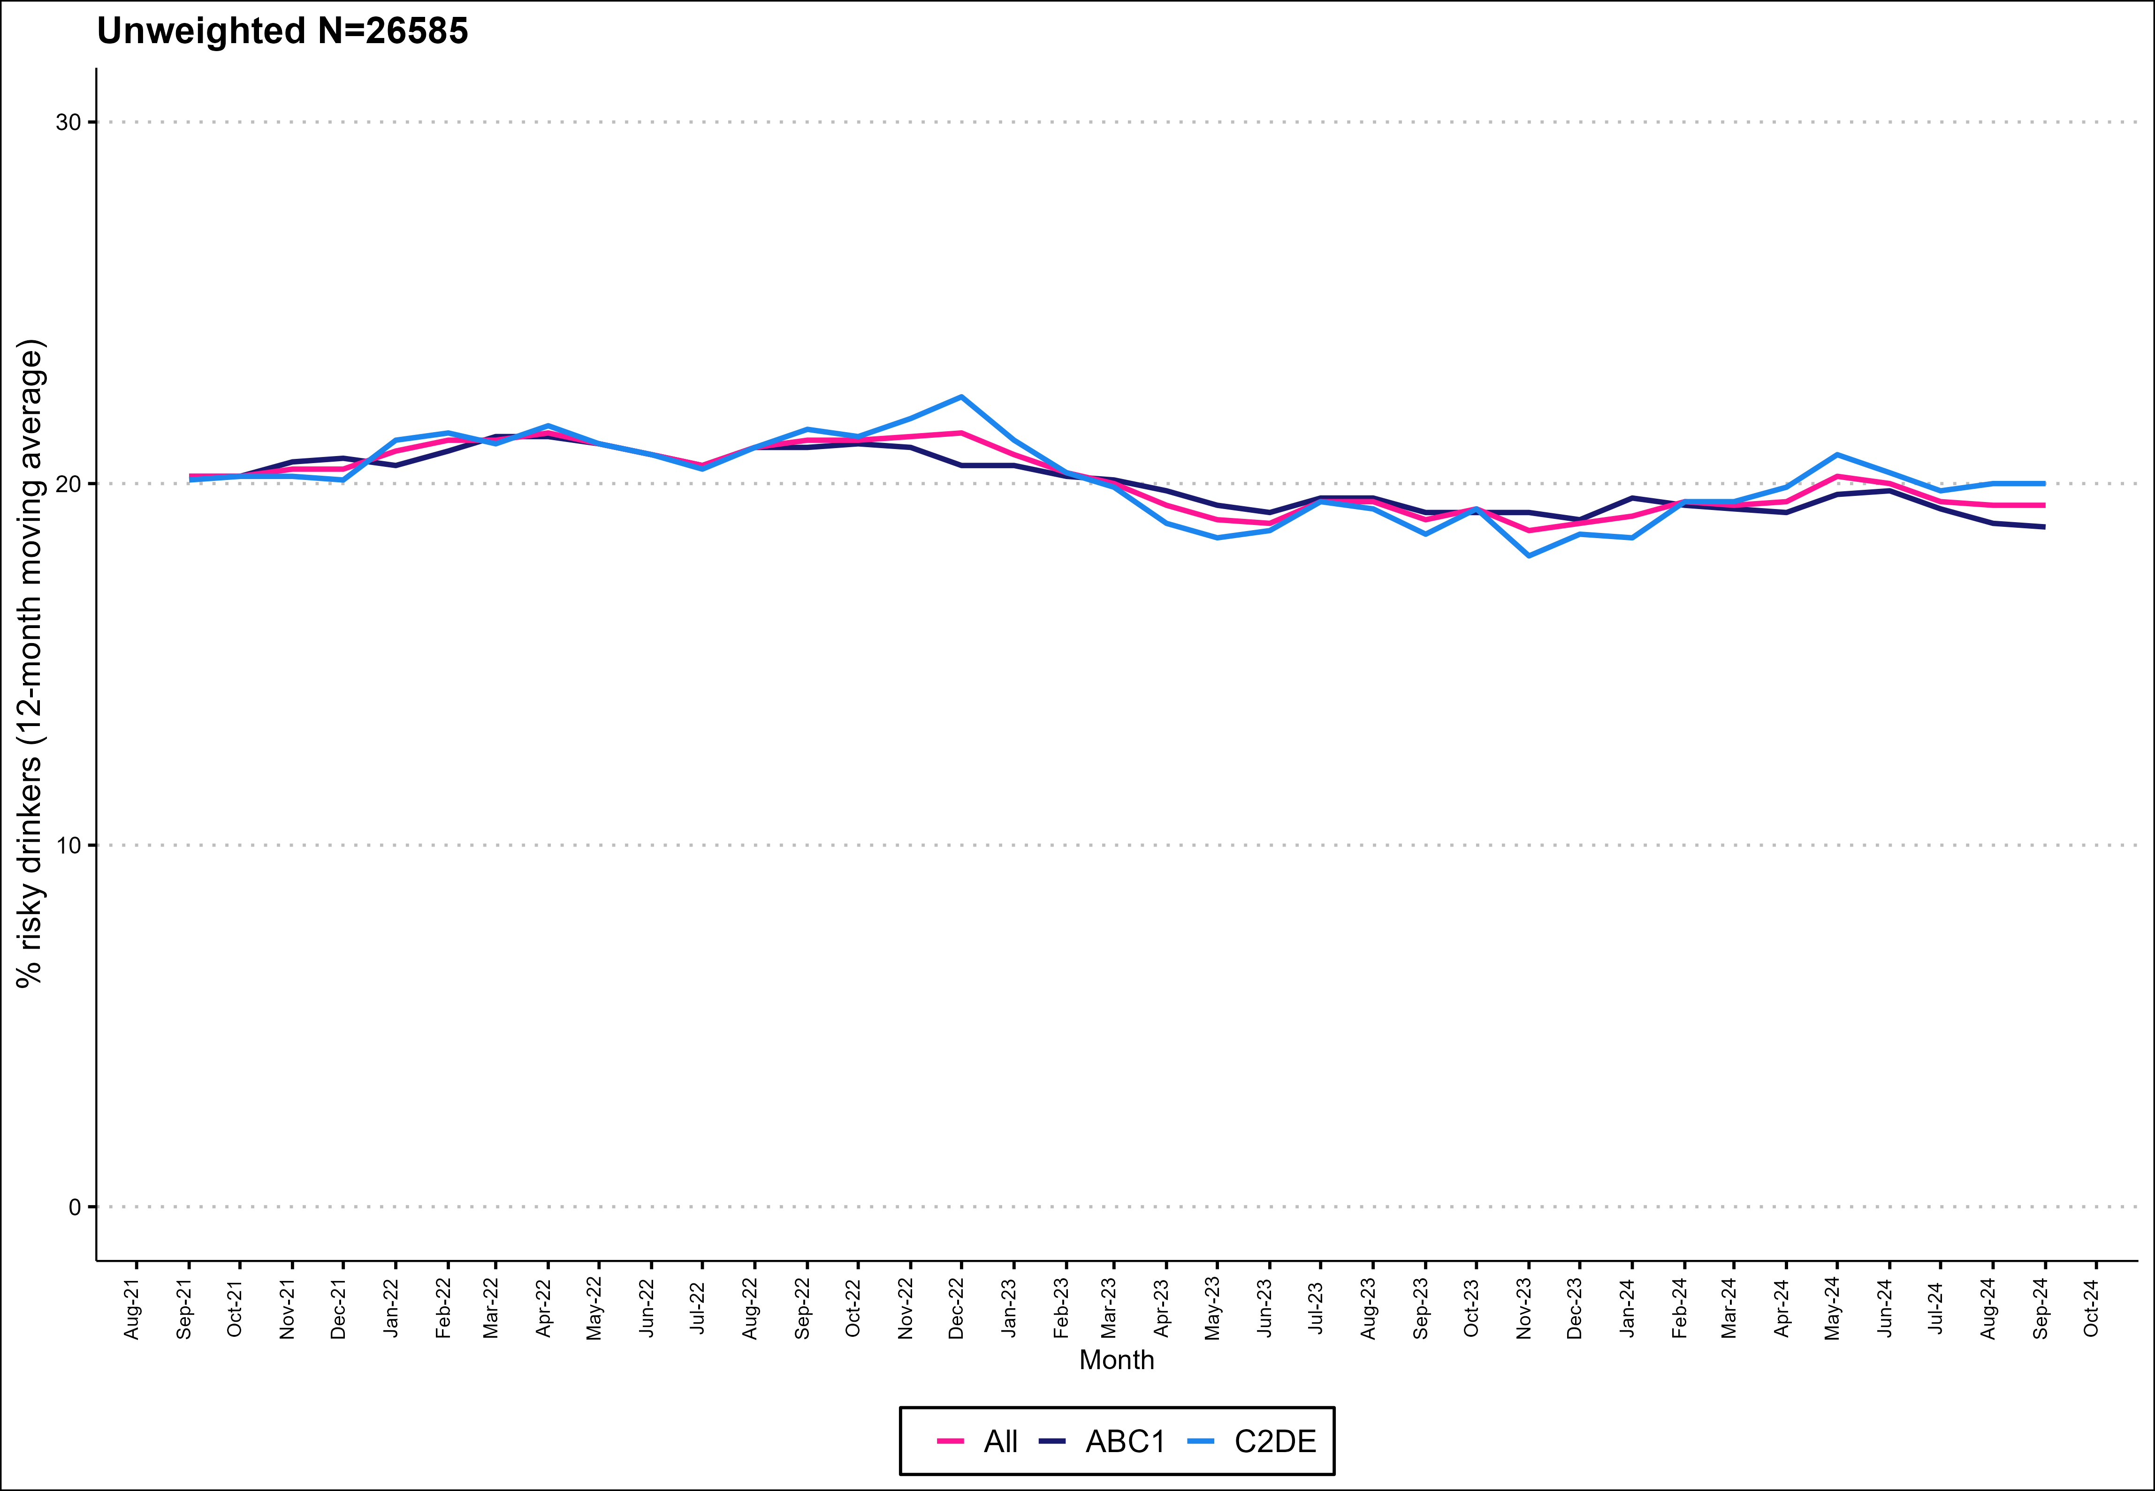
Prevalence of risky drinking (AUDIT) - not collected since October 2024

Slide 13
Methods
Data collected during monthly household survey
Each month involves a new representative sample of 400-450 adults (16 and over)
  Due to pandemic, surveys are conducted by telephone (rather than face-to-face) and among adults aged 18 and over between April 2020-December 2021.
Risky drinking operationalised as AUDIT-C of 5 or above (https://cks.nice.org.uk/topics/alcohol-problem-drinking/diagnosis/how-to-screen)
Kock, et al., 2021. Protocol for expansion of an existing national monthly survey of smoking behaviour and alcohol use in England to Scotland and Wales: The Smoking and Alcohol Toolkit Study. Wellcome Open Research. 6:67
More information (and access to the data underlying each graph) will be available online soon.

